Slide 1
Ontologies Theory and Applications
Slides for merging into main deck
Prepared by: Jackie Csonka
Contact: Jackie.Csonka@ibm.com

Slide 2
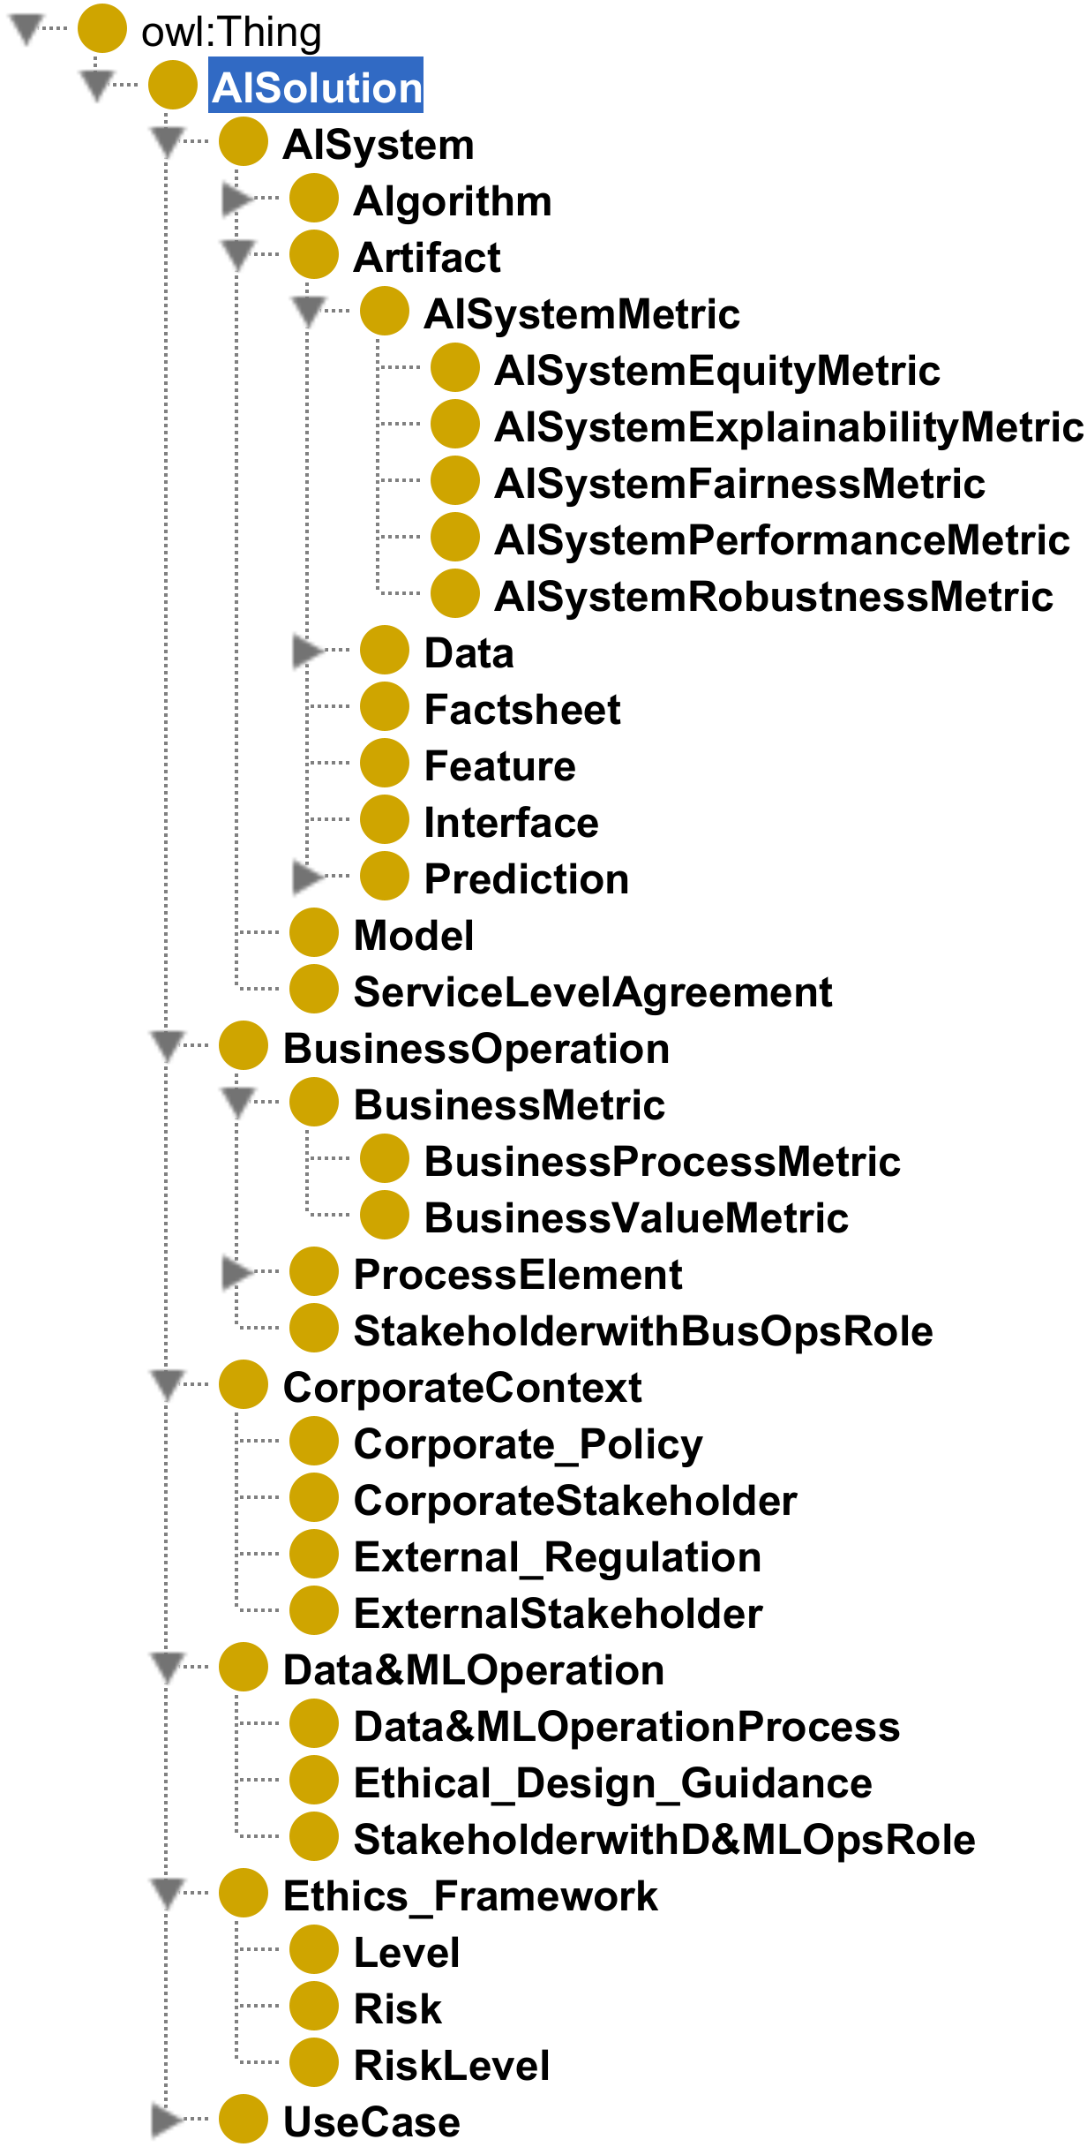
Sample ontology
Common semantic data structure
A formalization of domain knowledge
Facilitates communication
Continual refinement of concepts, definitions, relationships
Ontology for Factsheets
Contact: Jackie.Csonka@ibm.com

Slide 3
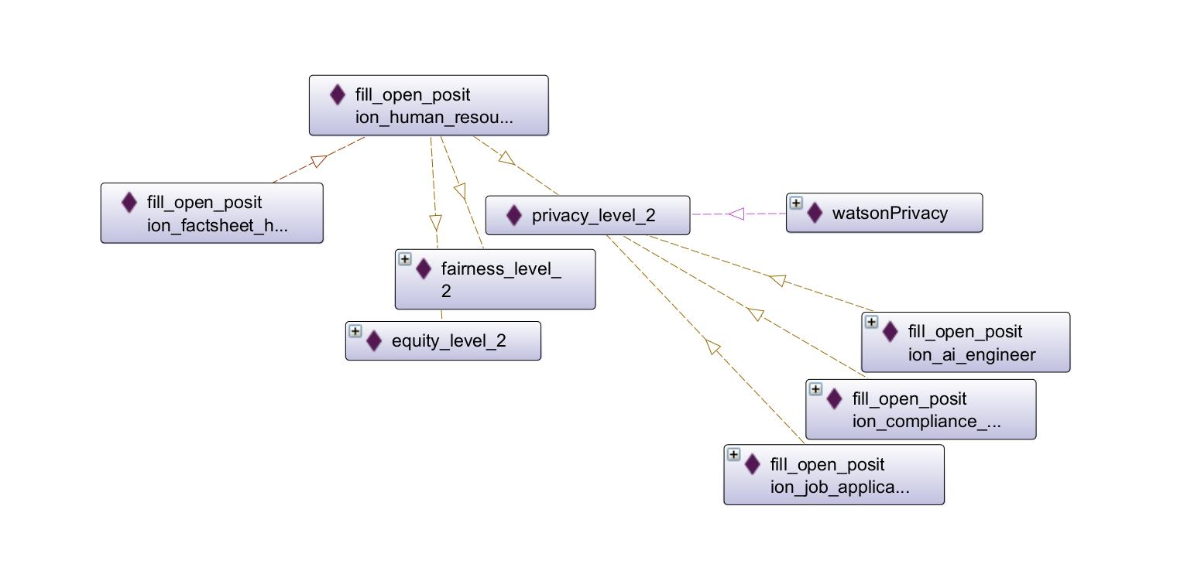
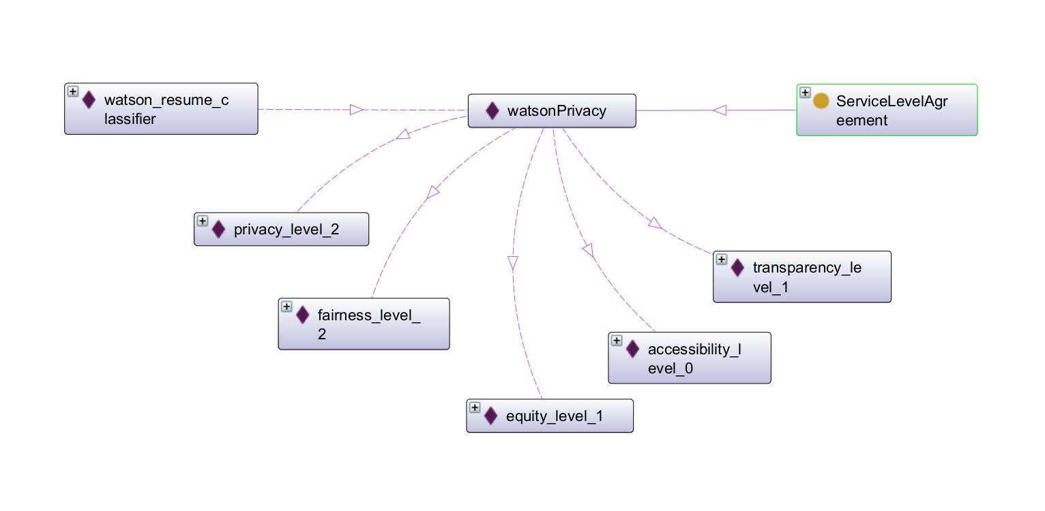
Ontology
for Factsheets
Human Resources Representative
AI to screen candidates
Ontology informs customization of Factsheet reports
Contact: Jackie.Csonka@ibm.com

Slide 4
Implementing ontology for Factsheets
Operationalization could include the following:
Workflow for gathering relevant facts, including both quantitative facts (e.g., model metrics) and qualitative facts (e.g., qualitative assessment of job applicant)
Governance of the lineage, modifications to, and retrieval of facts
Generation of customized Factsheet for stakeholders
Risk management
Continual improvement of the ontology
Contact: Jackie.Csonka@ibm.com

Slide 5
Appendix
For reference only

Slide 6
Operationalization example
ontology
Transparency matrix
(watson) Knowledge Catalog
Factsheet report
Customized for
each stakeholder
Governance is central
Knowledge Catalog contains all facts
Proof of concept using Transparency matrix
Factsheet for a stakeholder contains facts associated with that stakeholder
Sample matrix (YES: include in factsheet)
 | Data Scientist | Human Resources Representative | Job Candidate
Name | YES | YES
Created by | YES | YES
Last modified date of AI system | YES | YES
Input schema | YES
Input schema (explained) |  | YES
Hiring prediction | YES
Hiring prediction (explained) |  | YES | YES
Drift metric | YES
Privacy metric | YES
Privacy (explained) |  | YES | YES
Fairness metric | YES
Fairness (explained) |  | YES | YES
Equity metric | YES
Equity (explained) |  | YES | YES
Contact: Jackie.Csonka@ibm.com

Slide 7
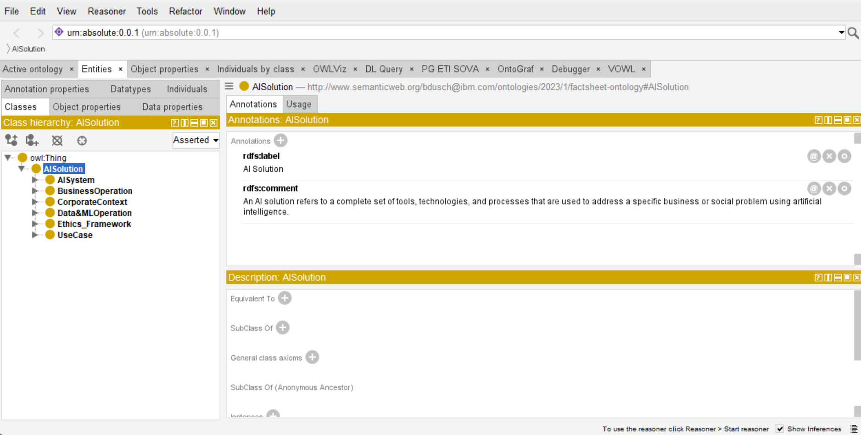
Contact: Jackie.Csonka@ibm.com

Slide 8
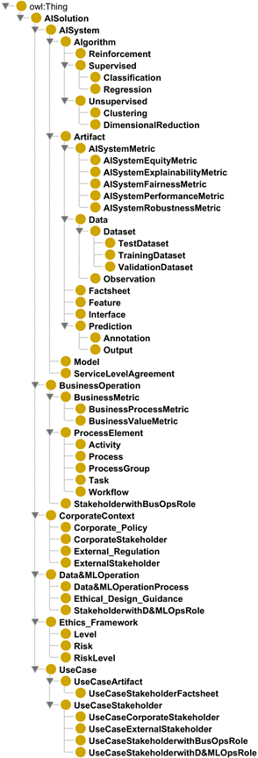
Contact: Jackie.Csonka@ibm.com

